Slide 1


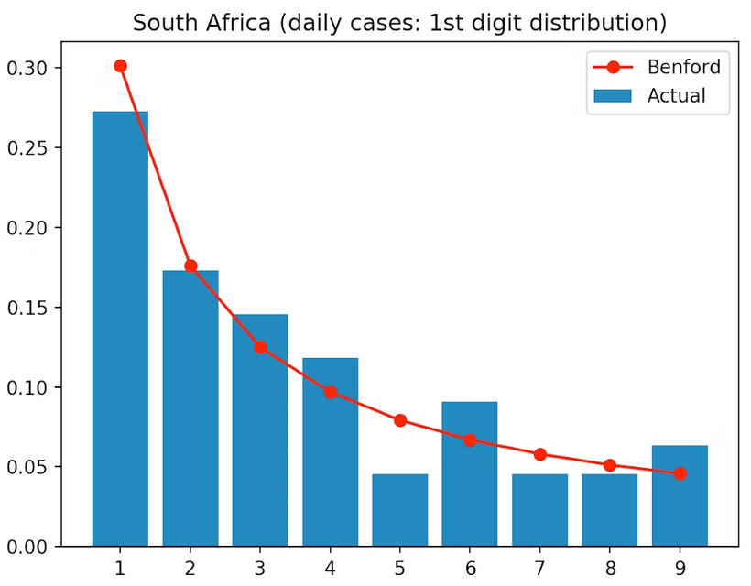

Benford’s Law Analysis
Air Quality Index of Indian Cities
Team- Lassi
Vansh Agarwal
Saad Arqam
Pathan Amaan
Premansh Behl
Notes:
1

Slide 2

Introduction to Benford’s Law & AQI
Benford’s Law
Digit Frequency
Predicts frequency of leading digits in natural data
Lower digits appear more often than higher digits
Applications
Why AQI?
Fraud detection, data auditing, anomaly identification
Numerical, natural data ideal for Benford’s analysis
Notes:
2

Slide 3
Project Objectives
Examine AQI Values
Apply Benford’s Law
Detect Inconsistencies
Identify Deviations
Promote Transparency
Notes:
3

Slide 4
Data Collection & Preprocessing
Data Source
Preprocessing Steps
Open Government Data (India), CPCB
Removed missing and duplicates
Extracted first digits
Dataset
Counted digit frequencies
Daily AQI values for Indian cities over time
Normalized data
Tools
Python, Pandas, NumPy, Matplotlib, Seaborn
Notes:
4

Slide 5

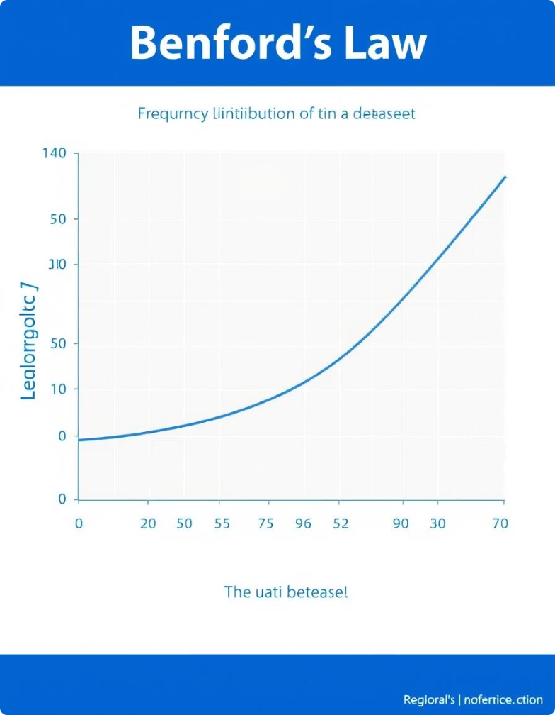




Understanding Benford’s Law
Formula
P(d) = log₁₀(1 + 1/d)
Expected %
1: 30.1%, 2: 17.6%, ..., 9: 4.6%
Key Insight
Distribution is logarithmic, not uniform
Use Cases
Finance, population, scientific data
Notes:
5

Slide 6
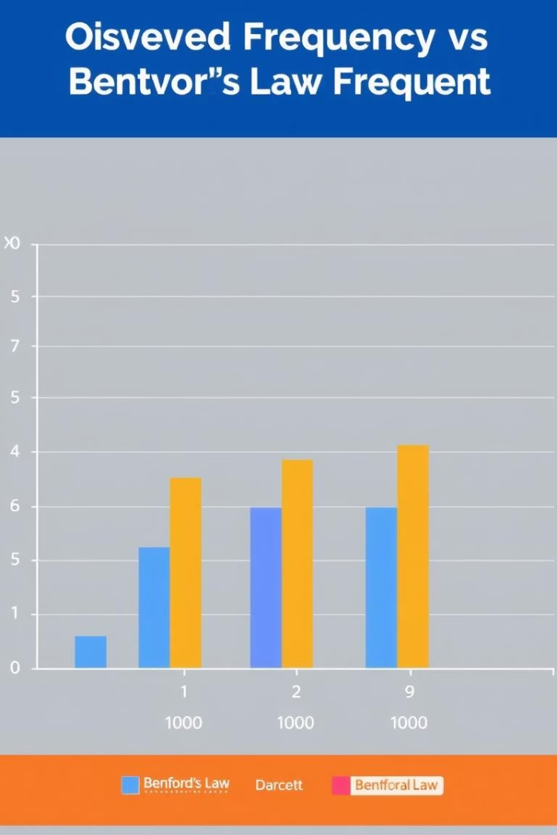
AQI First Digit Analysis
General Alignment
Most cities' AQI matches Benford’s Law
Deviations
Cities with moderate/extreme AQI show differences
Possible Causes
Overreporting or rounding near digits 2 and 5
Insight
Deviations mostly acceptable but need review
Notes:
6

Slide 7
Chi-Square Goodness of Fit Test
Purpose
Result Example
Test AQI digit distribution fit to Benford’s Law
χ² = 9.73, p = 0.23 (p > 0.05)
Formula
Conclusion
χ² = Σ[(Observed - Expected)² / Expected]
Fail to reject null hypothesis; data follows Benford’s Law
Minor deviations due to rounding or local factors
Notes:
7

Slide 8

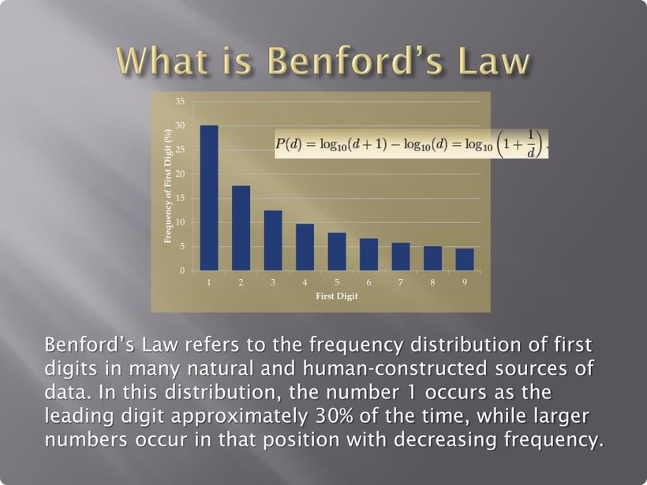
Key Findings
Findings
AQI mostly aligns with Benford’s Law
Chi-Square supports natural data hypothesis
Minor anomalies need further review
Benford’s Law aids data integrity verification
Notes:
8

Slide 9
Team Contributions
Vansh Agarwal
Saad Arqam
Pathan Amaan
Premansh Behl
Statistical analysis & coding
Data collection & cleaning
Visualization & graphs
Summary & presentation design
Notes:
9

Slide 10
Thank You !
We sincerely thank you for taking the time to go through our project.
Your attention and interest mean a lot to us.
If you have any questions, suggestions, or feedback,
we would be happy to connect and discuss further.
~Team Lassi
Notes:
10

